Slide 1
CAPSTONE PROJECT The Battle of Neighborhoods, Finding a Better Place in Scarborough, Toronto

Slide 2
INTRODUCTION
The purpose of this Project is to help people in exploring better facilities around their neighborhood. It will help people making smart and efficient decision on selecting great neighborhood out of numbers of other neighborhoods in Scarborough, Toronto.

Slide 3
DATA SECTION
https://en.wikipedia.org/wiki/List_of_postal_codes_of_Canada:_M
Scarborough dataset which scrapped from Wikipedia
Dataset consisting of latitude and longitude, zip codes

Slide 4
FOURSQUARE API DATA
The data retrieved from Foursquare contained information of venues within a specified distance of the longitude and latitude of the postcodes. The information obtained per venue as follows:
1. Neighborhood
2. Neighborhood Latitude
3. Neighborhood Longitude
4. Venue
5. Name of the venue e.g. the name of a store or restaurant
6. Venue Latitude
7. Venue Longitude
8. Venue Category

Slide 5
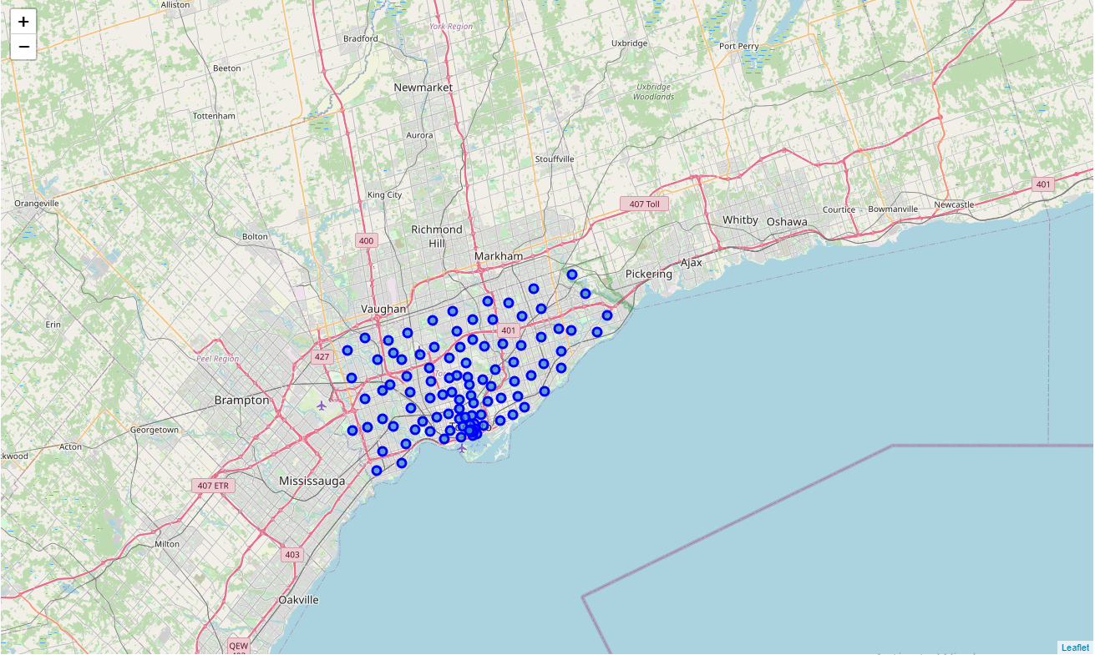
MAP OF SCARBOROUGH

Slide 6
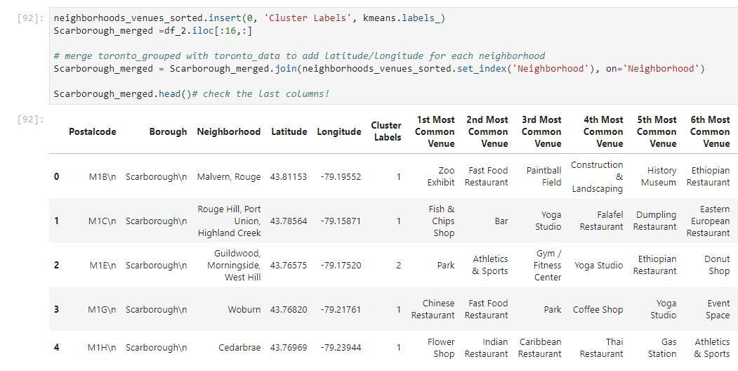
METHODOLOGY
K-Means Clustering Approach

Slide 7
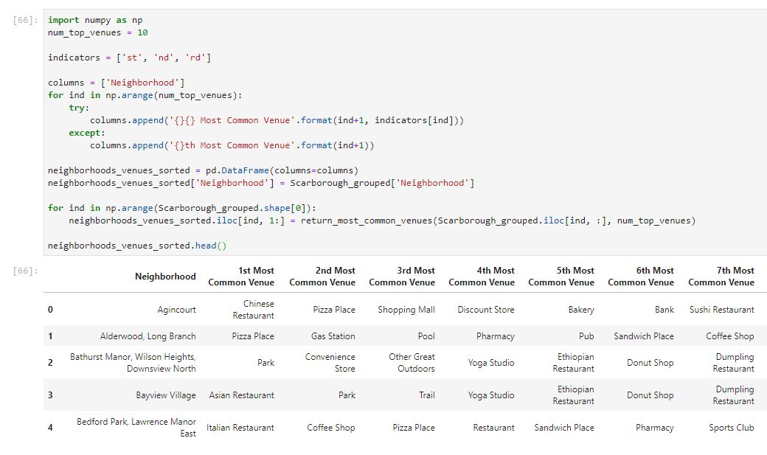
MOST COMMON VENUES NEAR NEIGHBOURHOOD

Slide 8
WORK FLOW
Using credentials of Foursquare API features of near-by places of the neighborhoods would be mined. Due to http request limitations the number of places per neighborhood parameter would reasonably be set to 100 and the radius parameter would be set to 500.

Slide 9
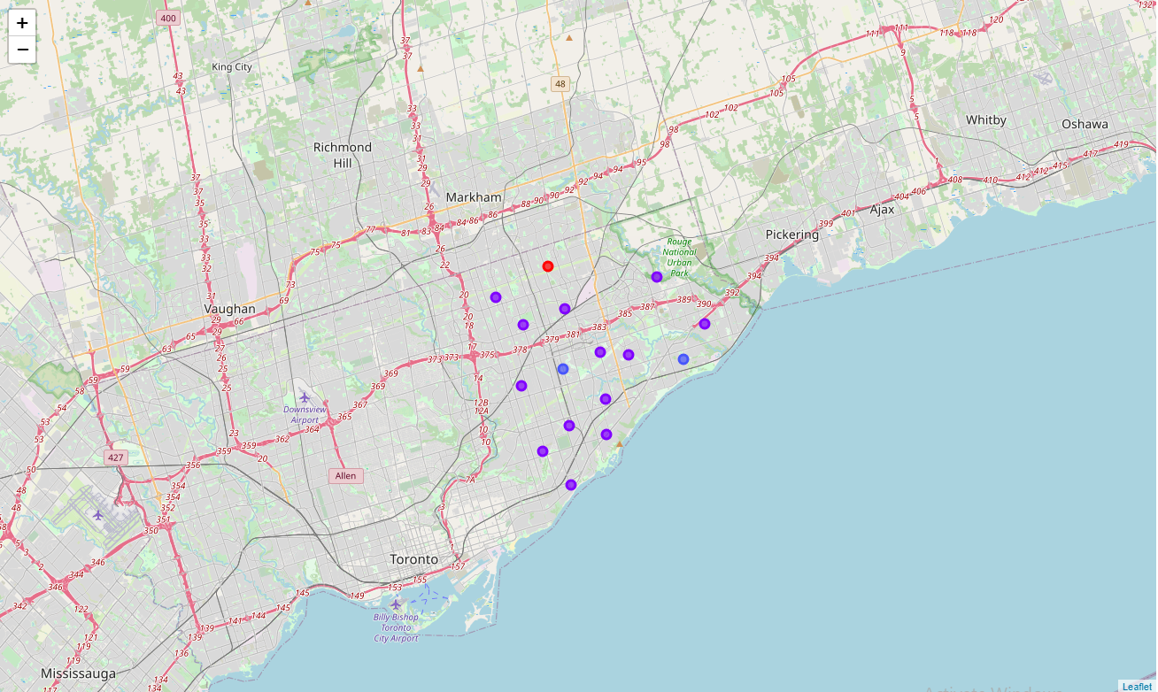
MAP OF CLUSTERS IN SCARBOROUGH

Slide 10
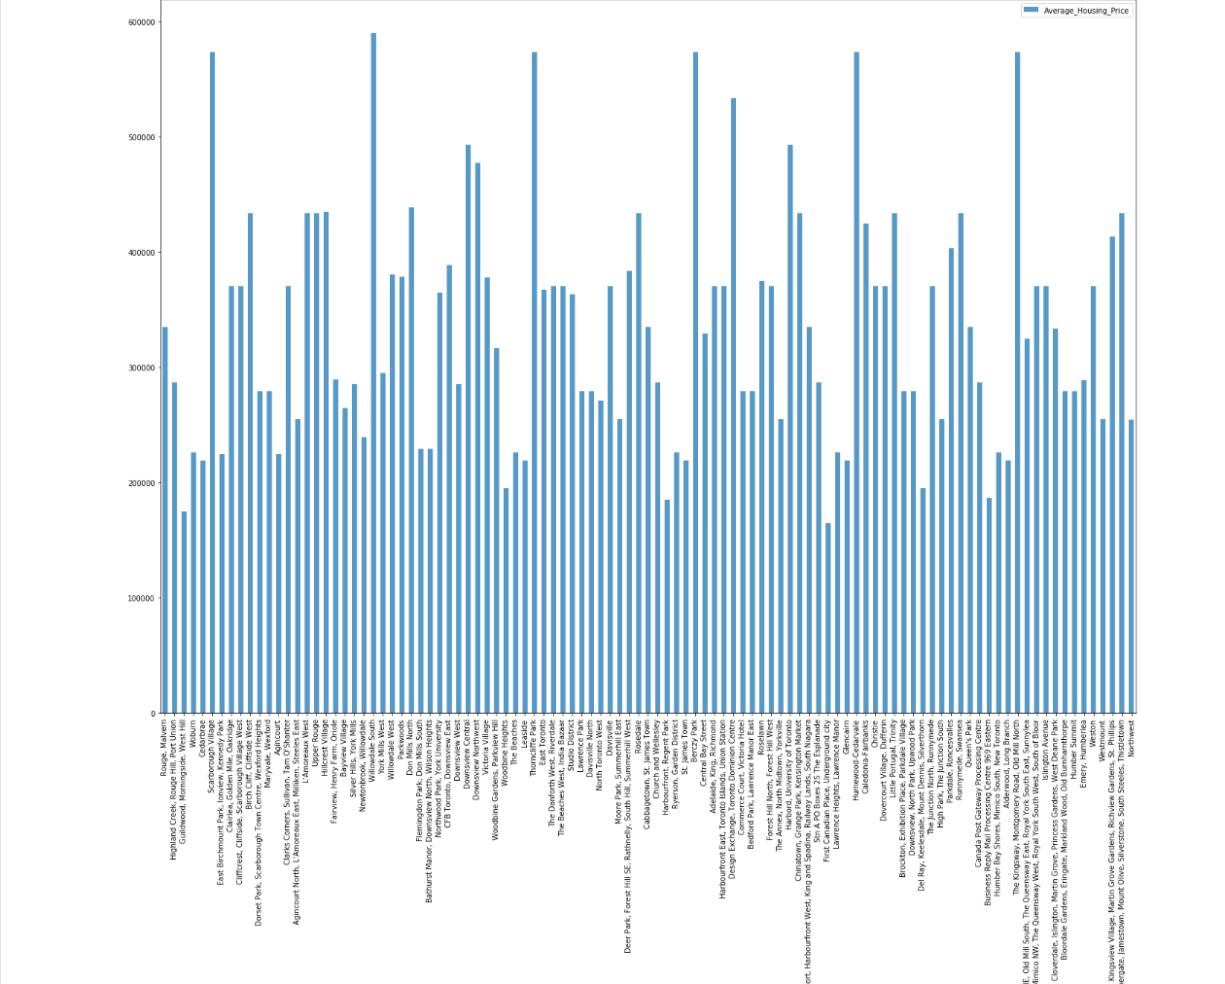
AVERAGE HOUSING PRICE BY CLUSTER IN SCARBOROUGH

Slide 11
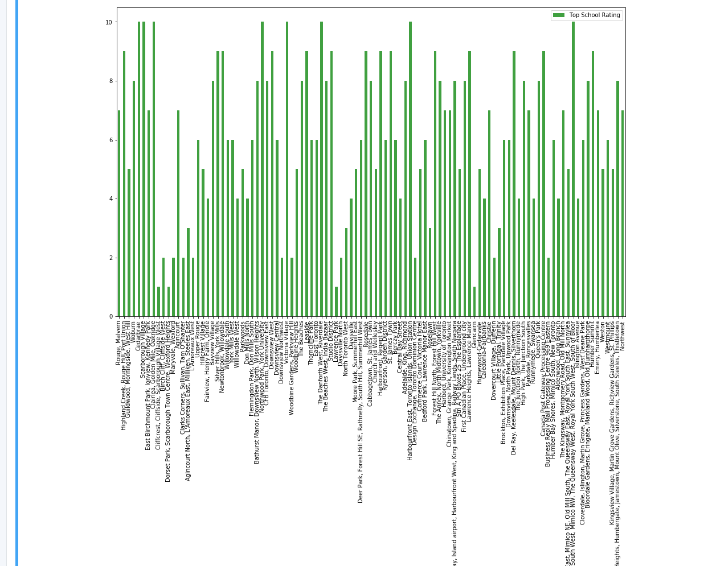
SCHOOL RATINGS BY CLUSTERS IN SCARBOROUGH

Slide 12
LOCATION
Scarborough is a popular destination for new immigrants in Canada to reside. As a result, it is one of the most diverse and multicultural areas in the Greater Toronto Area, being home to various religious groups and places of worship. Although immigration has become a hot topic over the past few years with more governments seeking more restrictions on immigrants and refugees, the general trend of immigration into Canada has been one of on the rise.

Slide 13
FOURSQUARE API
This project have used Four-square API as its prime data gathering source as it has a database of millions of places, especially their places API which provides the ability to perform location search, location sharing and details about a business.

Slide 14
PROBLEM WHICH TRIED TO SOLVE
The major purpose of this project is to suggest a better neighborhood in a new city for the person who is shifting there. Social presence in society in terms of likeminded people. Connectivity to the airport, bus stand, city center, markets and other daily needs things nearby.
Sorted list of house in terms of housing prices in a ascending or descending order
Sorted list of schools in terms of location, fees, rating and reviews

Slide 15
LIBRARIES USED
Pandas: For creating and manipulating data frames.
Folium: Python visualization library would be used to visualize the neighborhoods cluster distribution of using interactive leaflet map.
Scikit Learn: For importing k-means clustering.
JSON: Library to handle JSON files.
XML: To separate data from presentation and XML stores data in plain text format.
Geocoder: To retrieve Location Data.
Beautiful Soup and Requests: To scrap and library to handle http requests.
Matplotlib: Python Plotting Module.

Slide 16
CONCLUSION
In this project, using k-means cluster algorithm I separated the neighborhood into 10(Ten) different clusters and for 103 different latitude and longitude from dataset, which have very-similar neighborhoods around them. Using the charts above results presented to a particular neighborhood based on average house prices and school ratings have been made.
I feel rewarded with the efforts and believe this course with all the topics covered is well worth of appreciation. This project has shown me a practical application to resolve a real situation that has impacting personal and financial impact using Data Science tools. The mapping with Folium is a very powerful technique to consolidate information and make the analysis and decision better with confidence.

